Slide 1
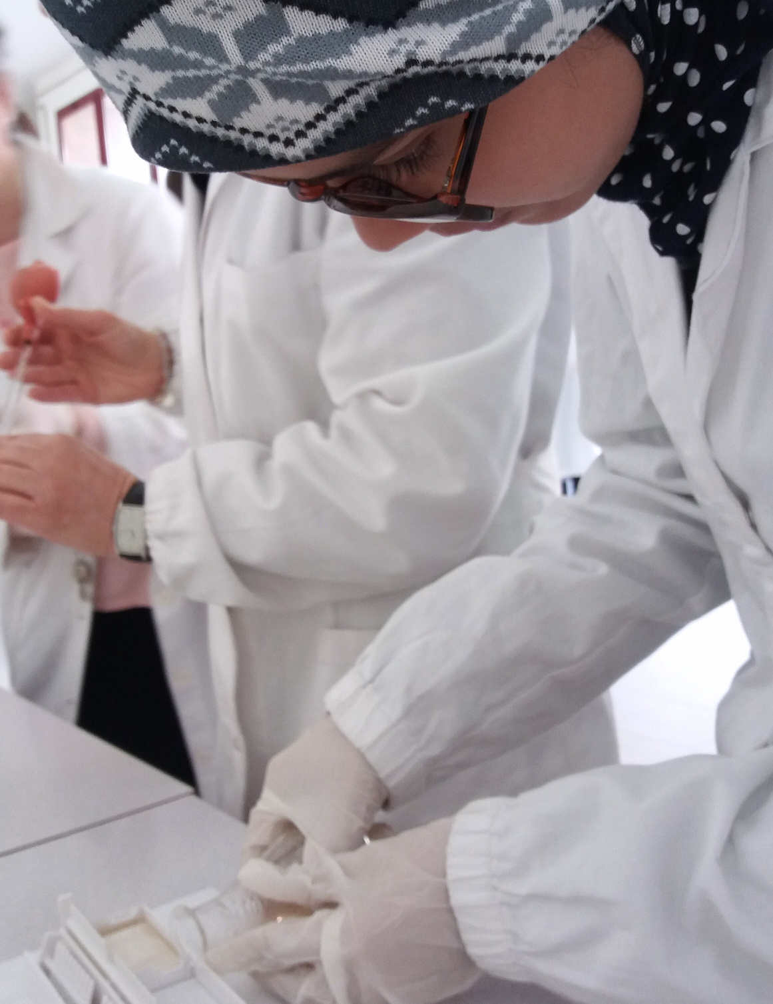



AMGEN
BIOTECH
EXPERIENCE
ABE brings critical hands-on biotechnology learning experiences into classrooms in select Amgen locations across the globe

Slide 2
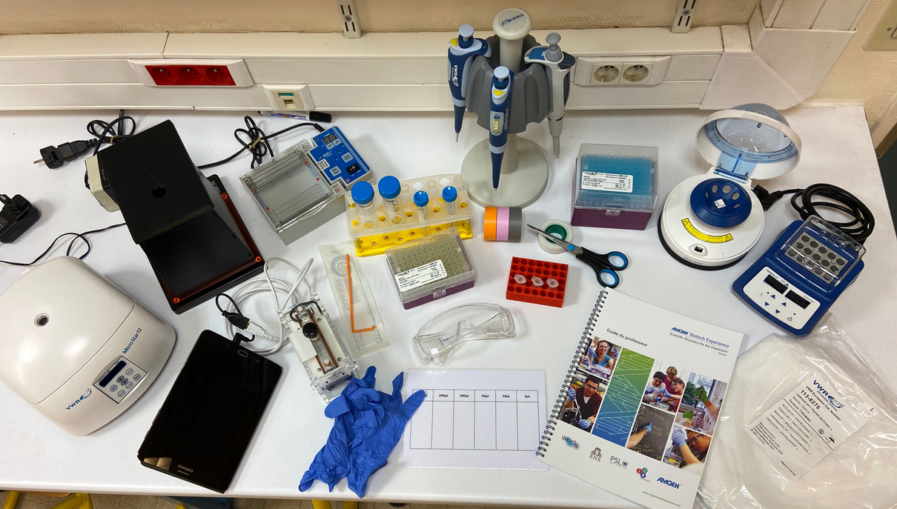
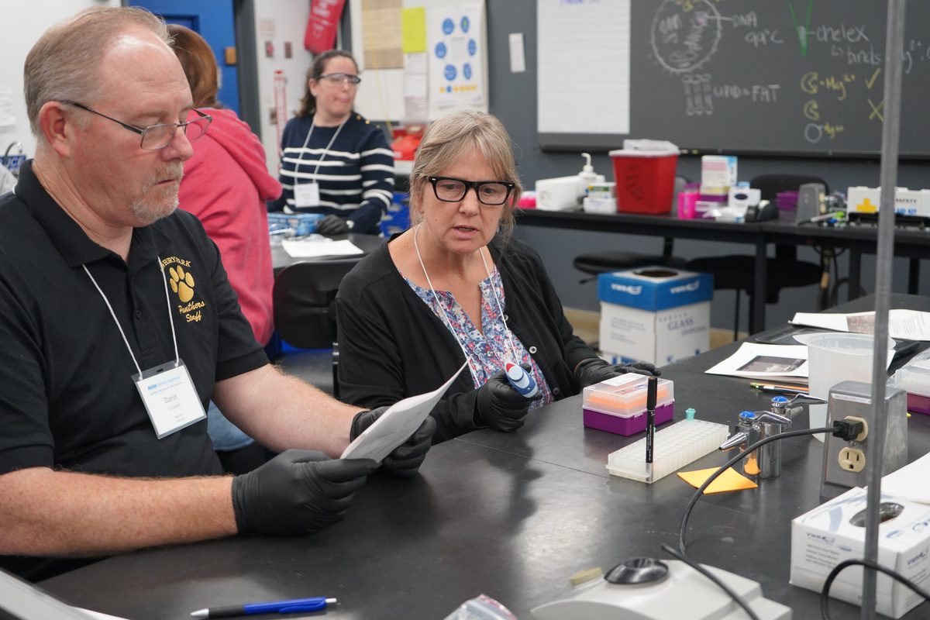
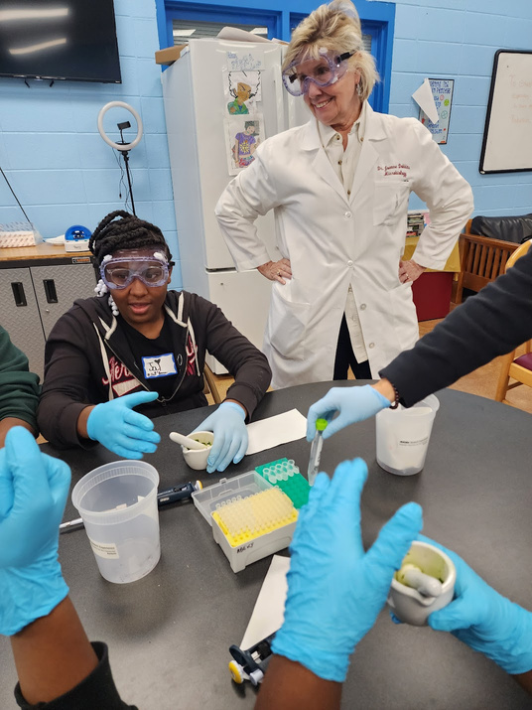
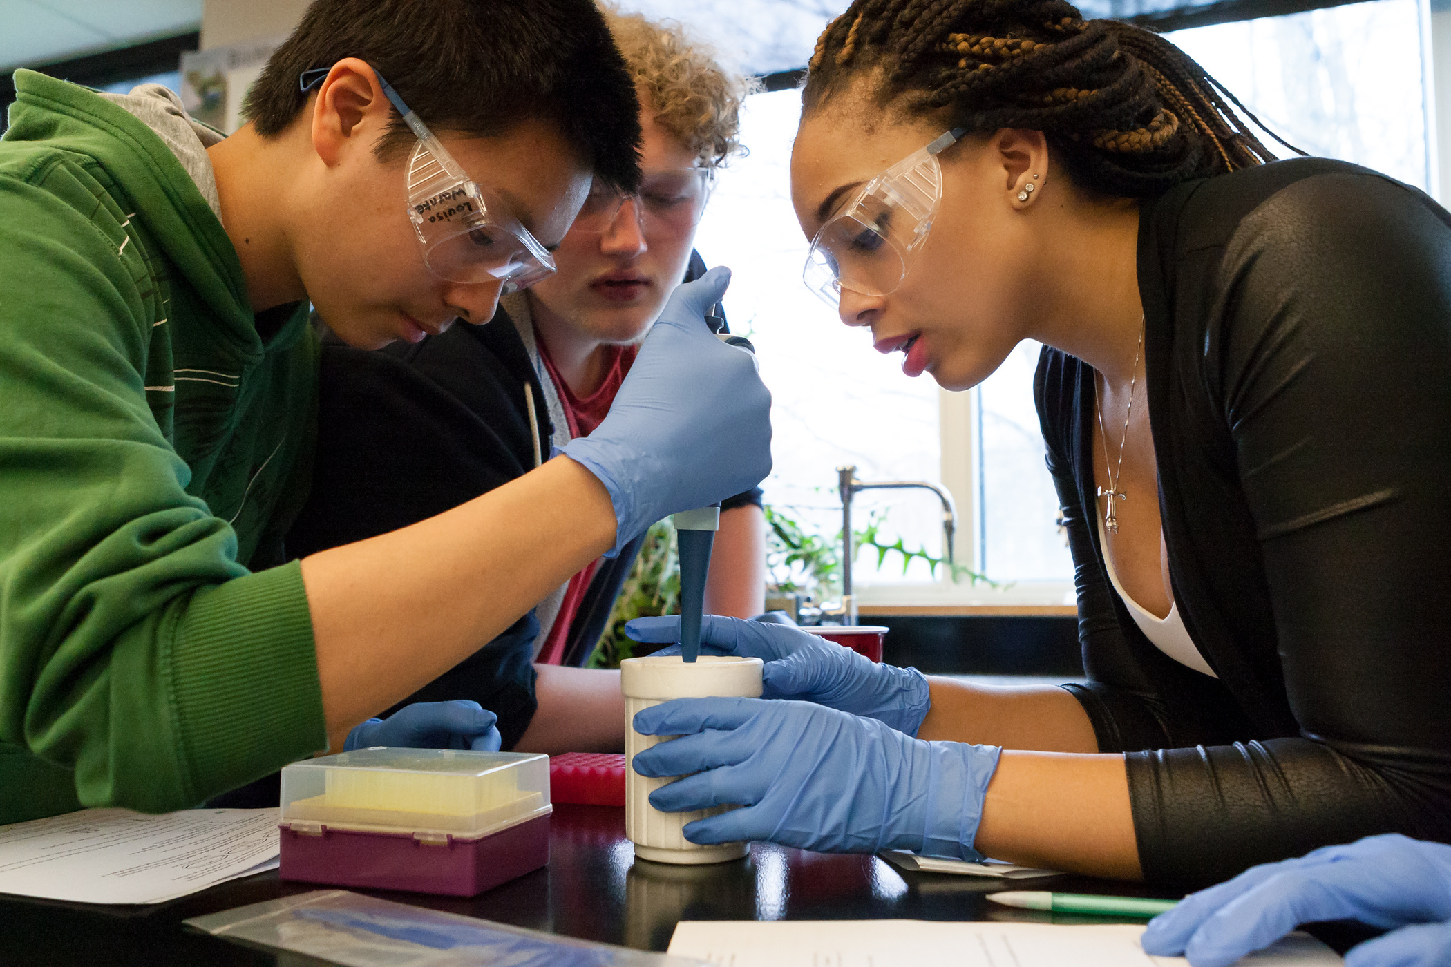
THE ABE
PROGRAM
1. Teaching Resources & Equipment
2. Teacher Professional Learning & Community
ABE introduces secondary students to the excitement of scientific discovery.
ABE provides access to cutting-edge science through four key areas:
3. Connecting Scientists to Classrooms
4. Equity & Access in STEM

Slide 3

OUR HISTORY
ABE was developed in Los Angeles in 1990. Since then, we have expanded to 27 program sites in 16 countries and reached 1 million students around the world.
1
27
1990
Million Students
Program Sites
16
2024
Countries

Slide 4
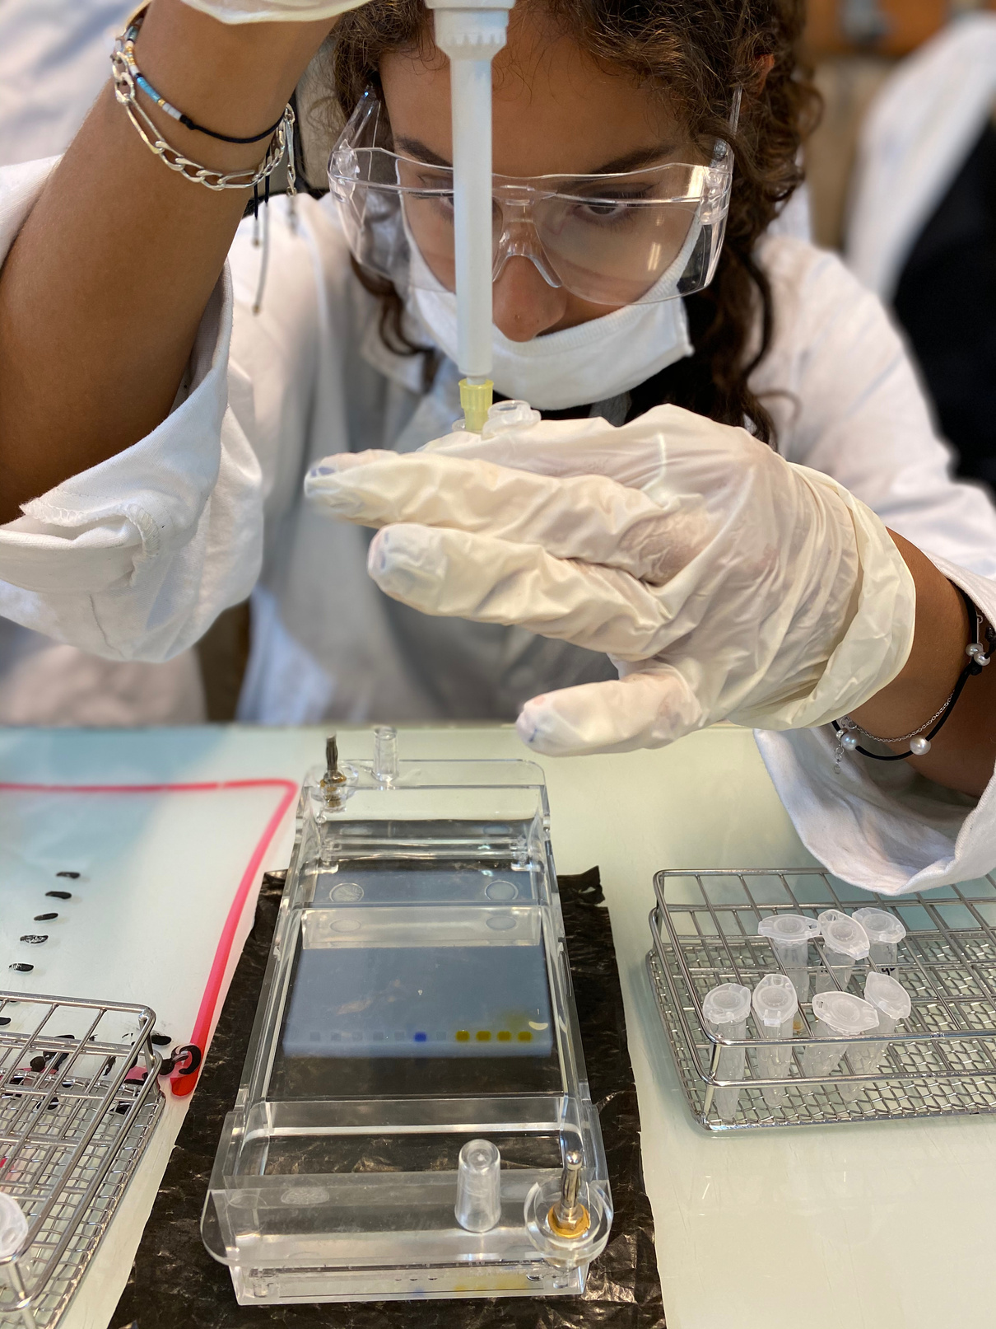



ANNUAL IMPACT
80,000 Students
1,500 Teachers
1,000 Schools

Slide 5
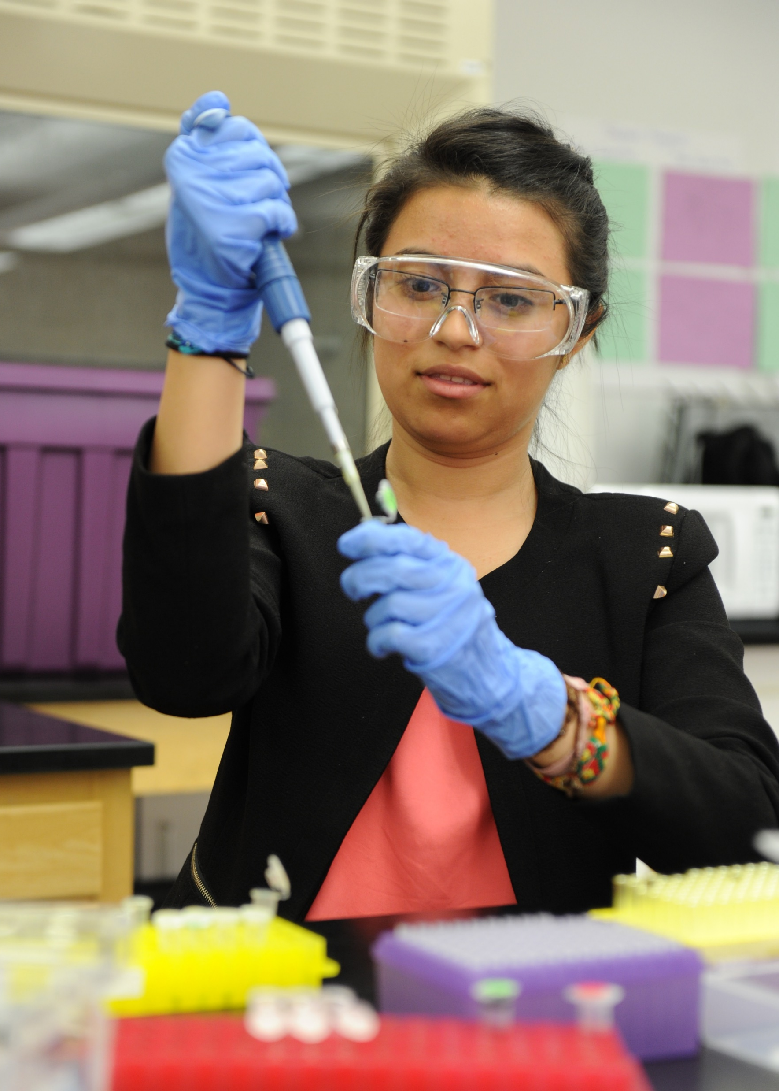

PROGRAM IMPACT
Evaluation studies indicate that ABE is effective with both teachers and students and is unique and valuable because it includes hands-on, real-life science.
An evaluation of student outcomes found that:
  Students improve their abilities to interpret experimental results and their knowledge of biotechnology skills.
  Students gain new ideas about what happens in science laboratories and what science is.
  Students increase their interest in science and science education.

Slide 6
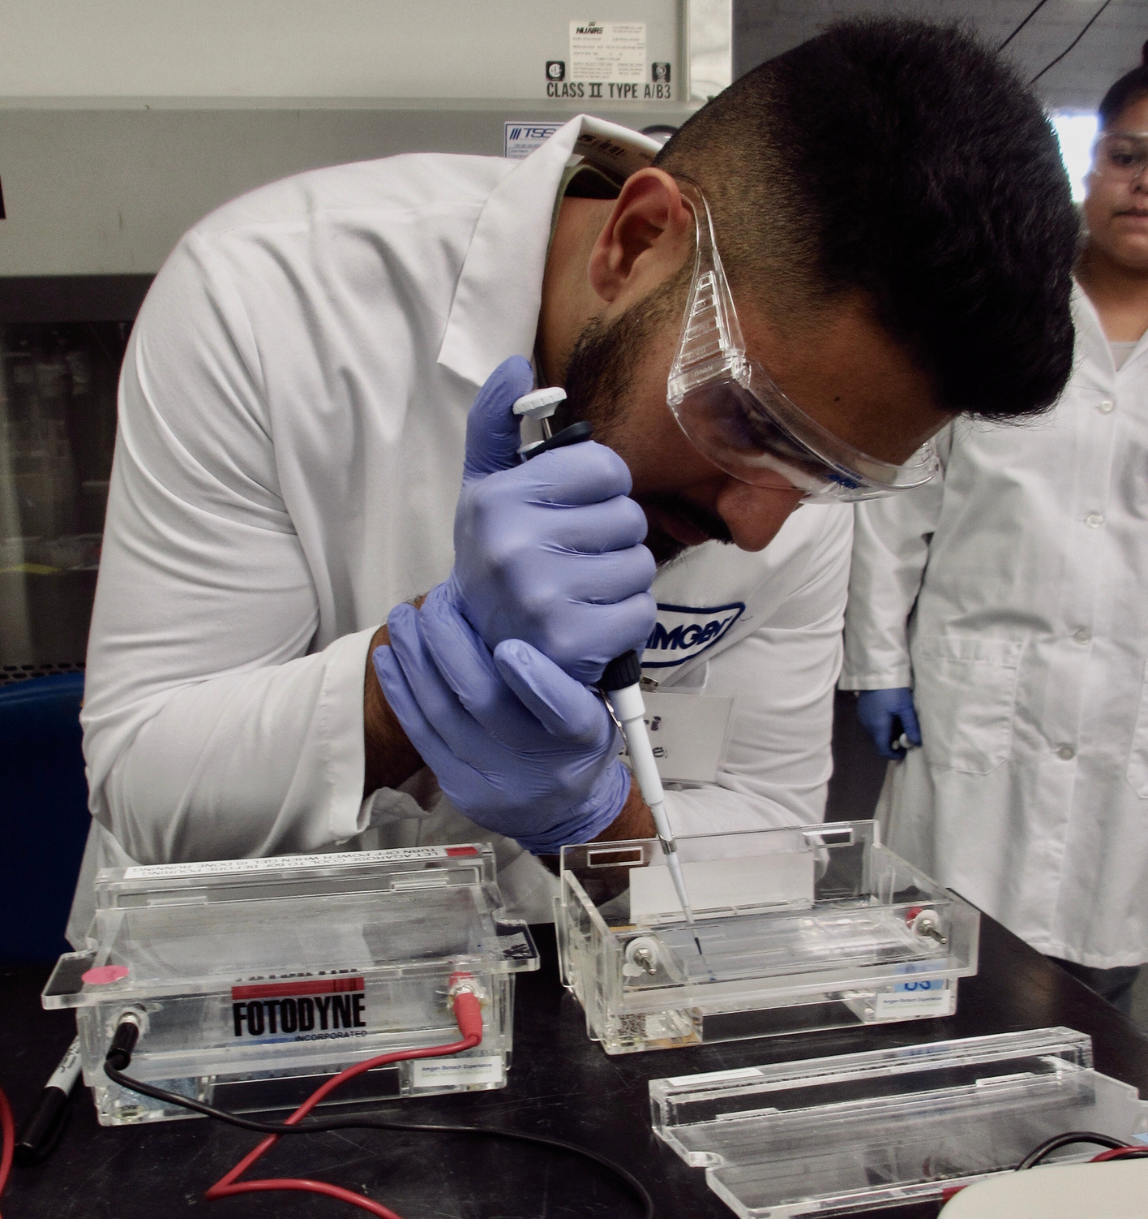

EQUITY & ABE
Systemic bias and discrimination affect STEM educational practices and opportunities.
ABE employs strategies and promotes practices to advance opportunities for underrepresented populations to succeed in bioscience.

Slide 7
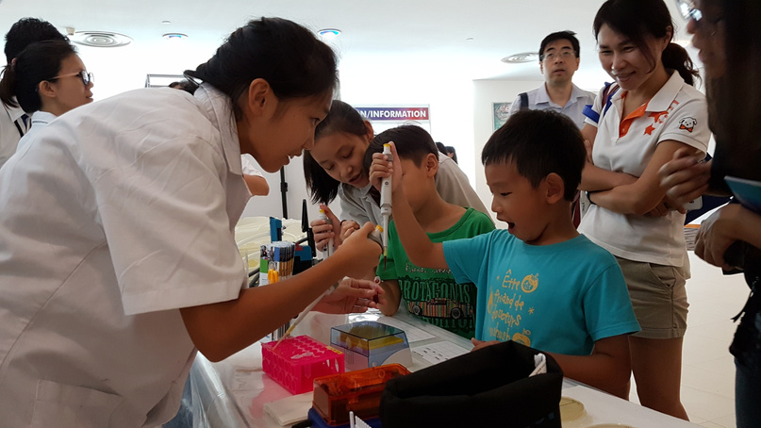


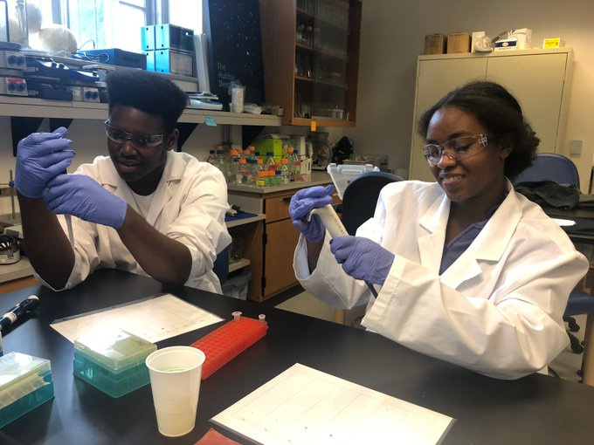
ABE'S COMMITMENT TO EQUITY
  Prioritize and value equity, diversity, and inclusion across the program
  Include diverse perspectives and people as program designers, implementers, and participants
  Develop resources and supports to increase ABE’s relevance and accessibility to diverse students and communities
  Expand program implementation models to increase access and opportunities for diverse populations

Slide 8
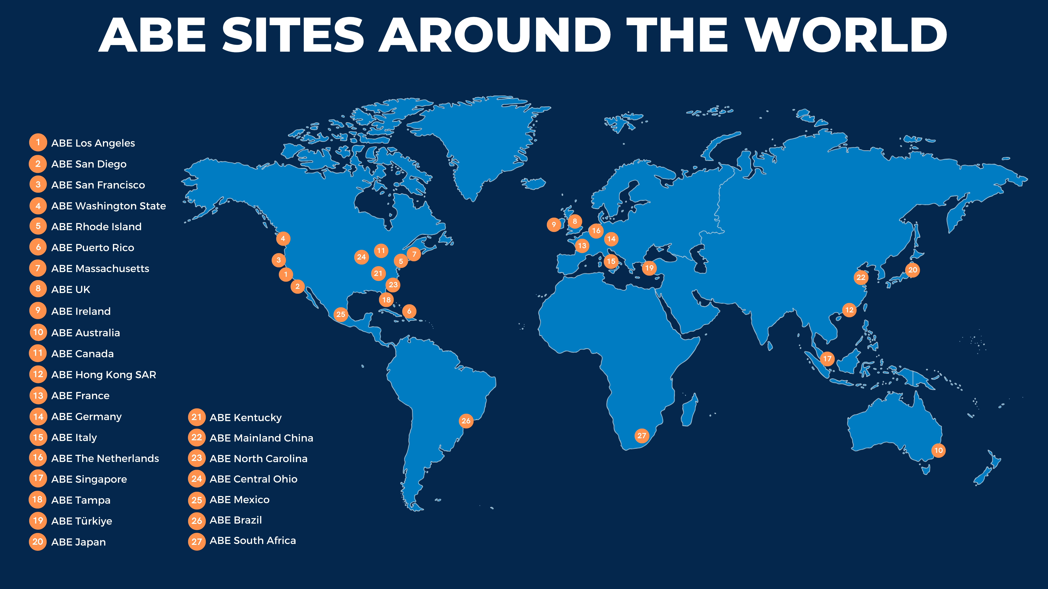
Sites are in the order in which they joined the ABE program.

Slide 9
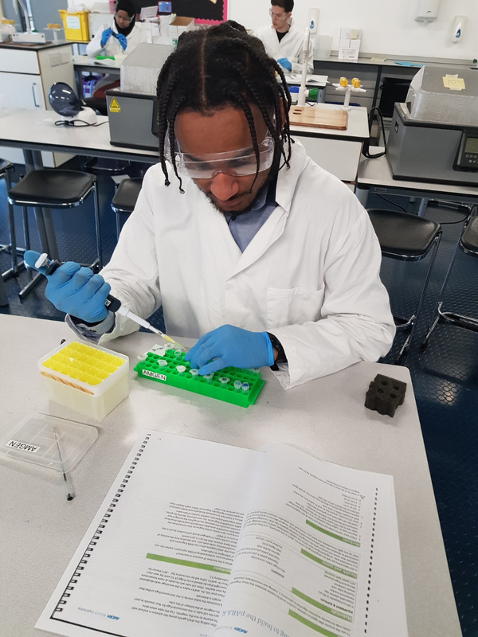
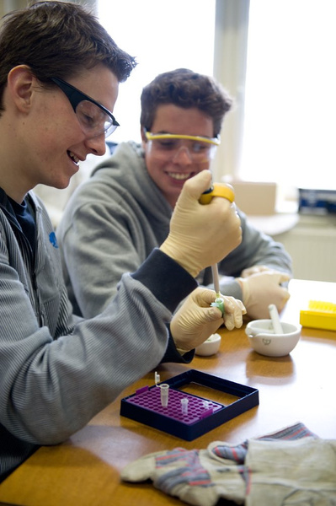
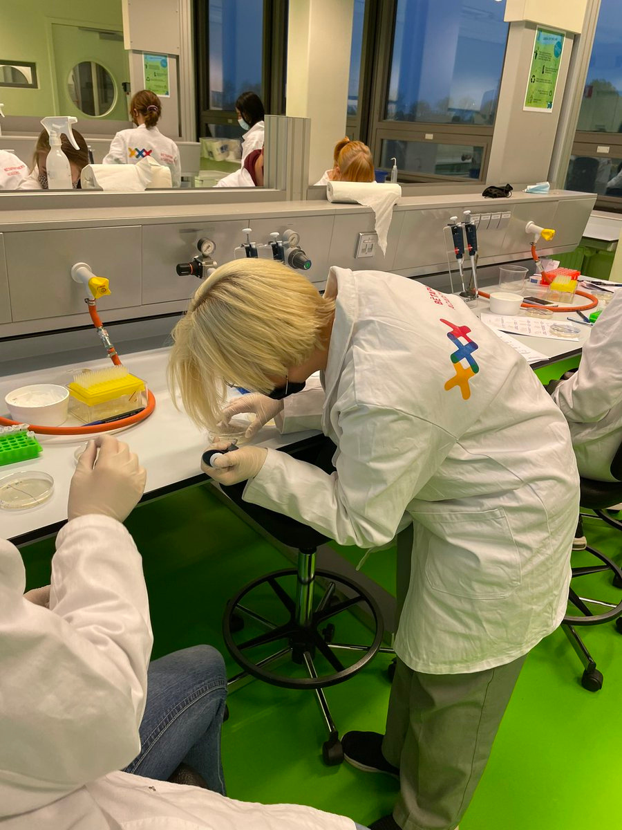
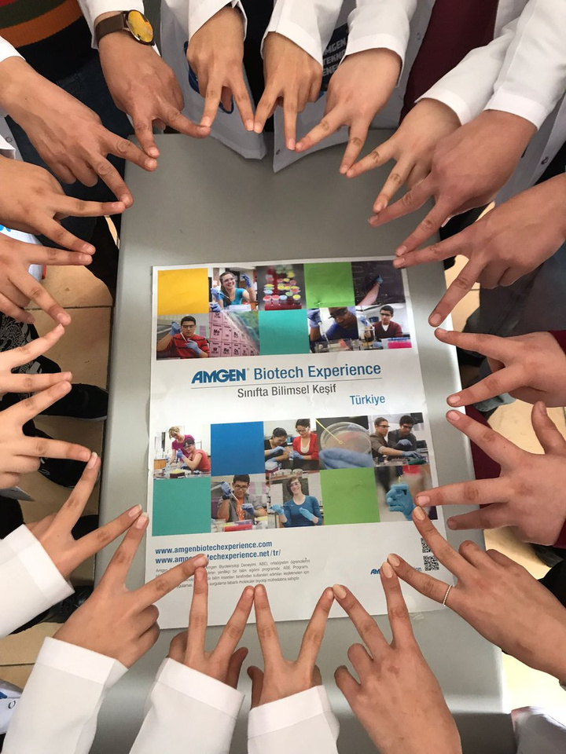
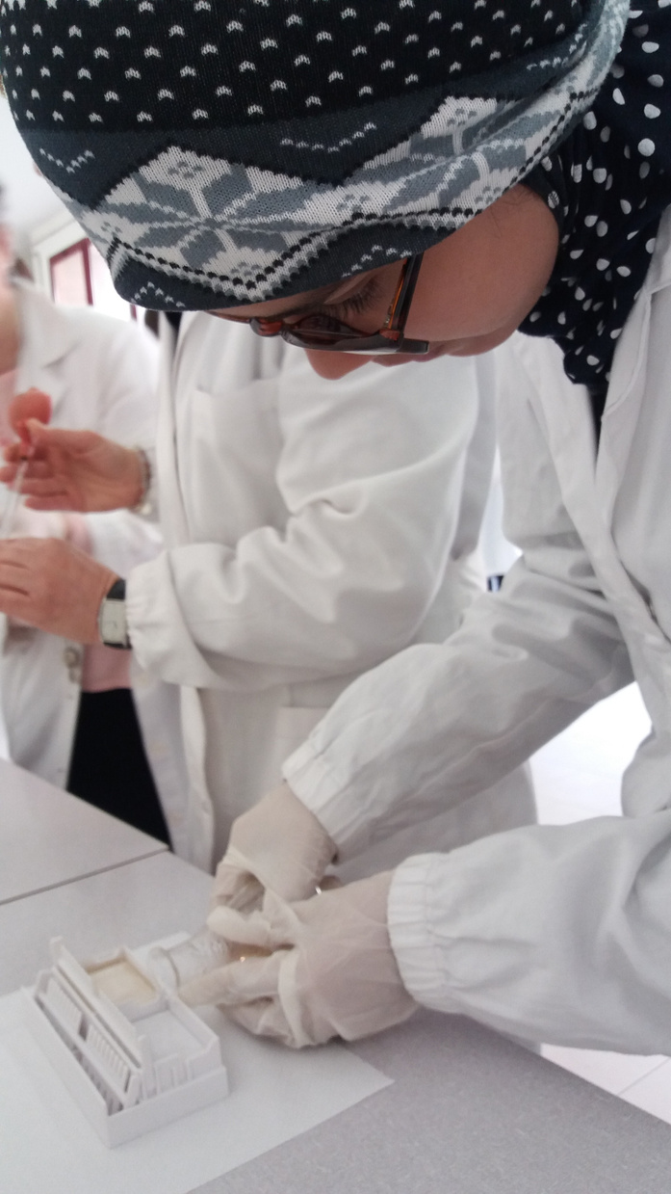
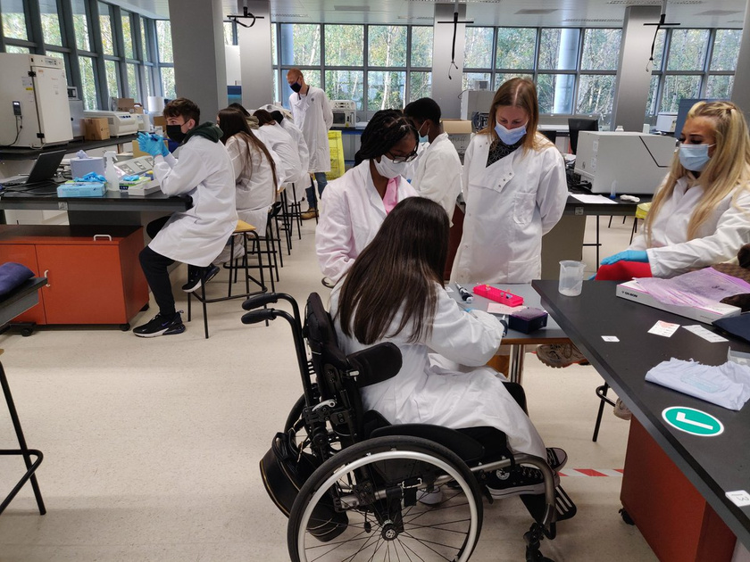

ABE
EUROPE, AFRICA, THE MIDDLE EAST
France | South Africa
Germany | The Netherlands
Ireland | Türkiye
Italy | United Kingdom

Slide 10
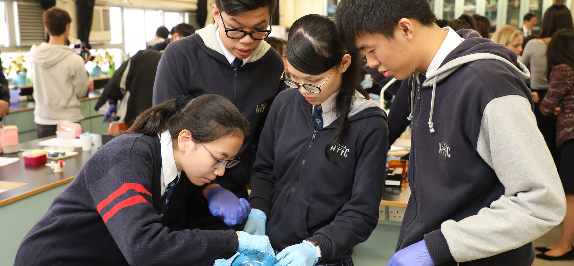
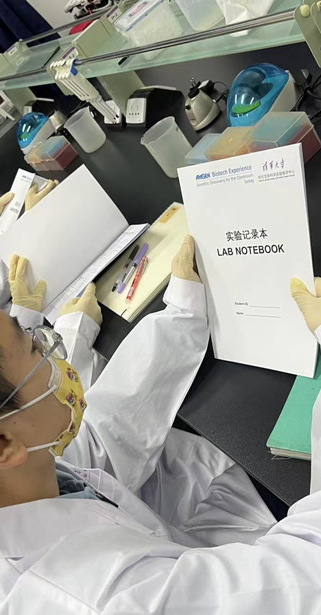
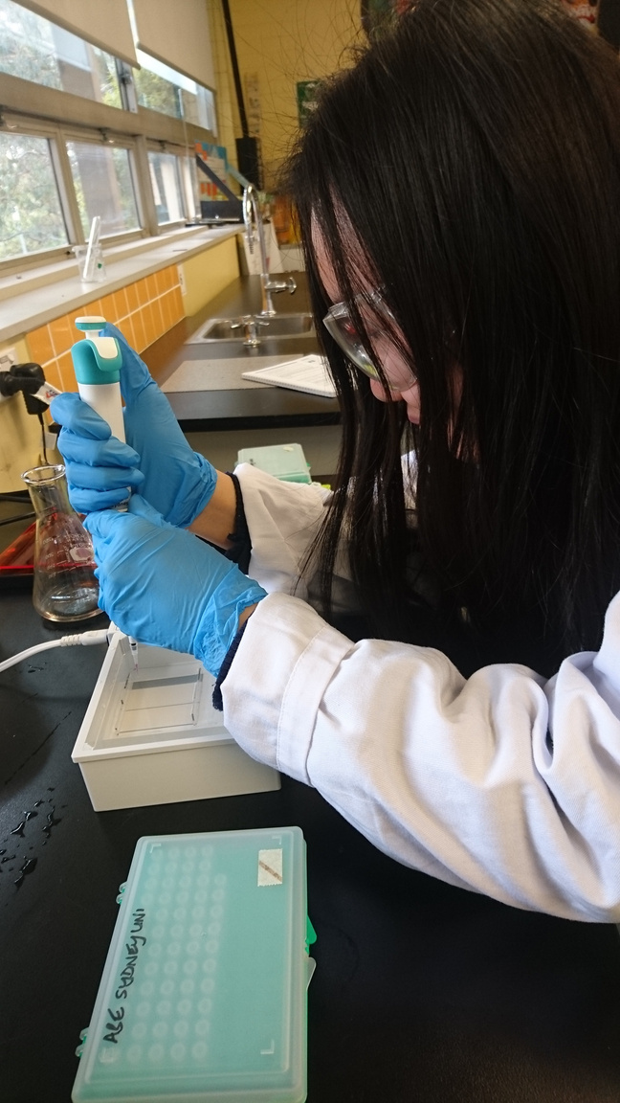
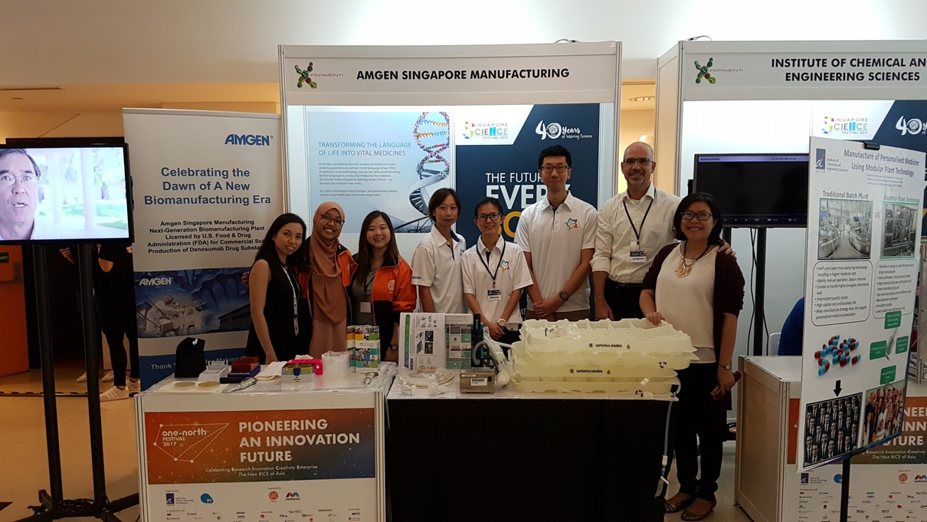
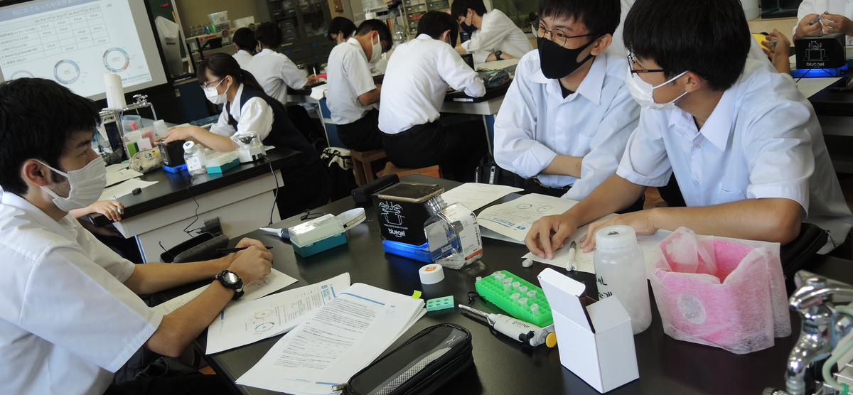
ABE
ASIA PACIFIC
Australia
Hong Kong SAR
Japan
Mainland China
Singapore

Slide 11
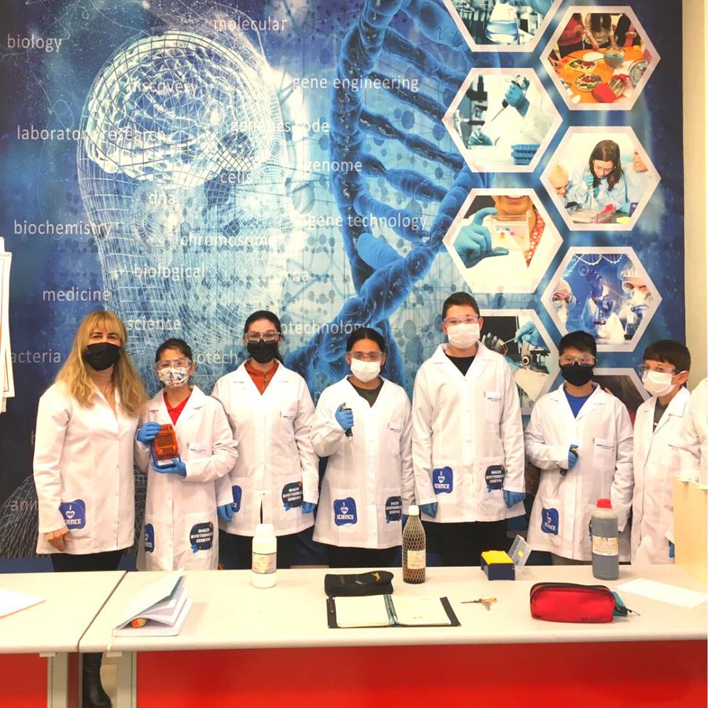
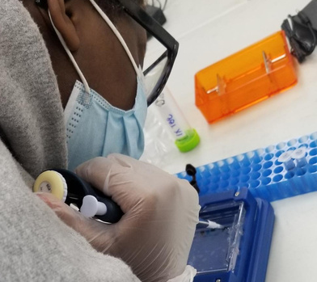
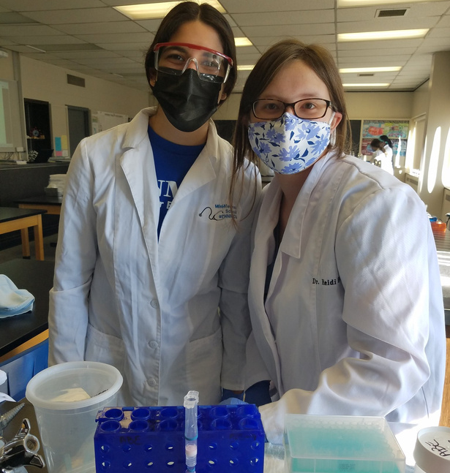
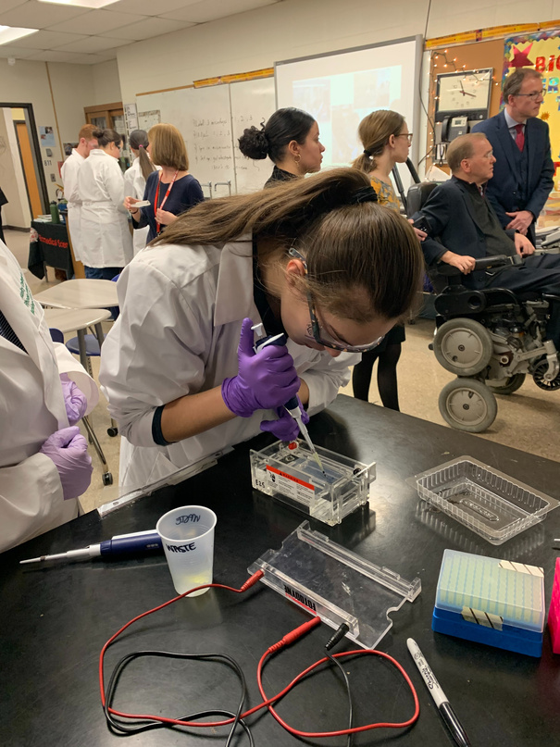

ABE THE AMERICAS
Brazil
Canada
Mexico
United States

Slide 12
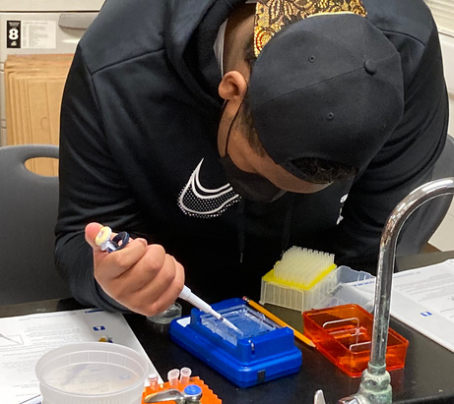
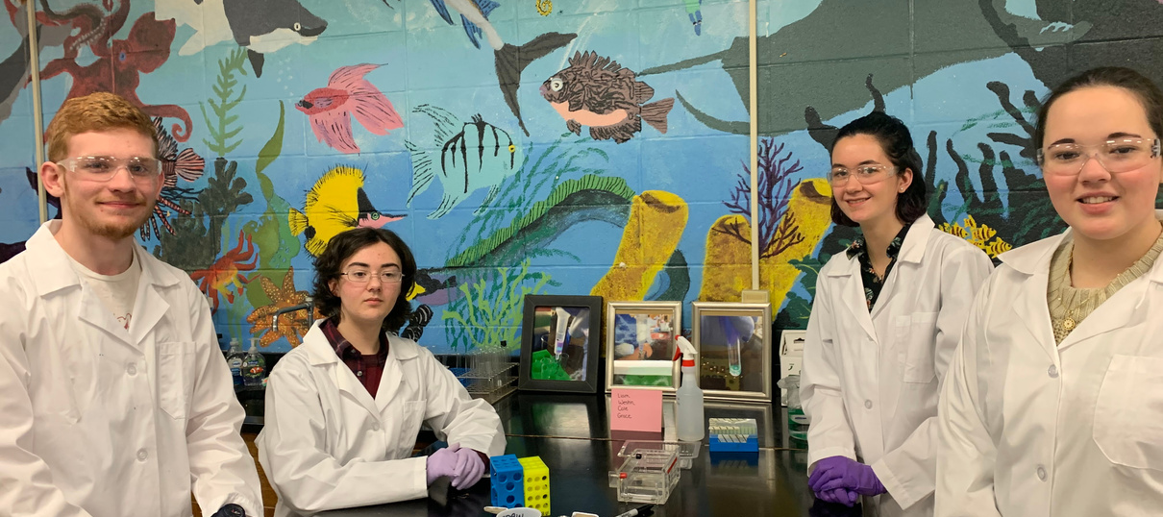
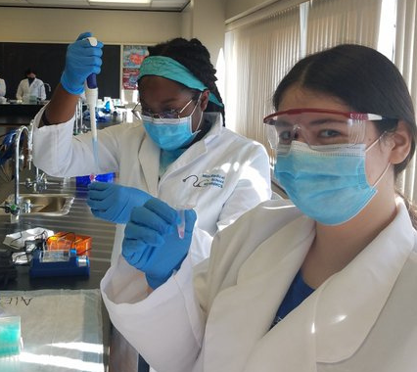
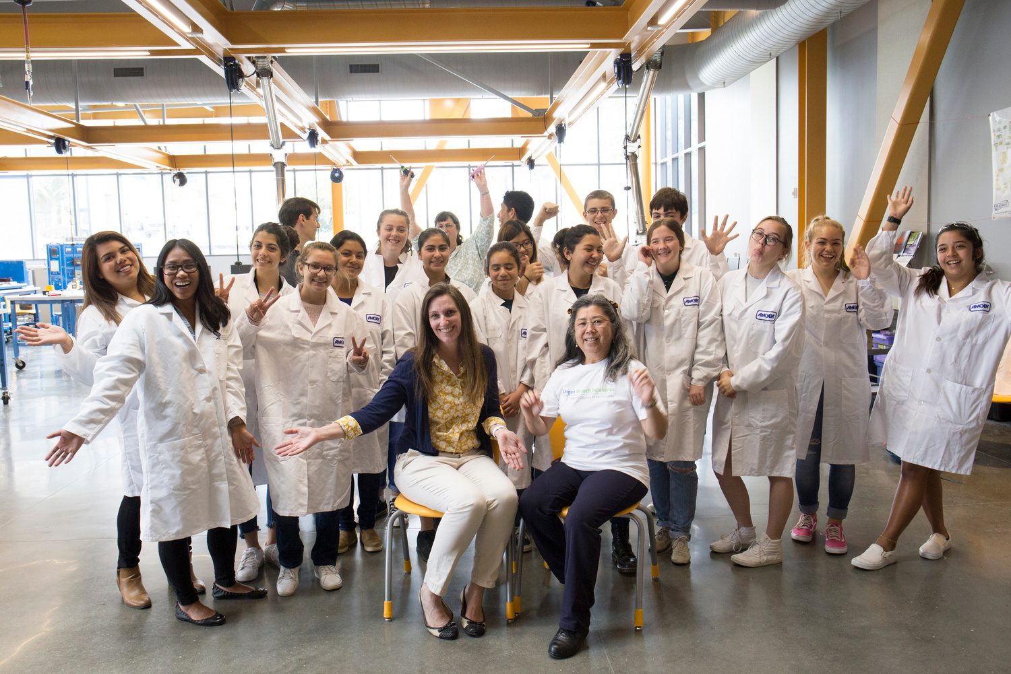
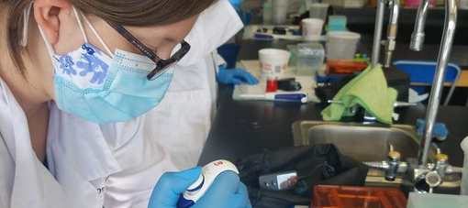


ABE USA
Central Ohio | Rhode Island
Greater Los Angeles | San Diego (affiliate)
Kentucky | San Francisco Bay
Massachusetts | Tampa
North Carolina | Washington State (affiliate)
Puerto Rico
An affiliate site is not funded by the Amgen Foundation.

Slide 13


ABE PROGRAM SITES
TEACHER
BENEFITS
SITE STAFF
COMMUNITY OF
PRACTICE
EVALUATION

Slide 14



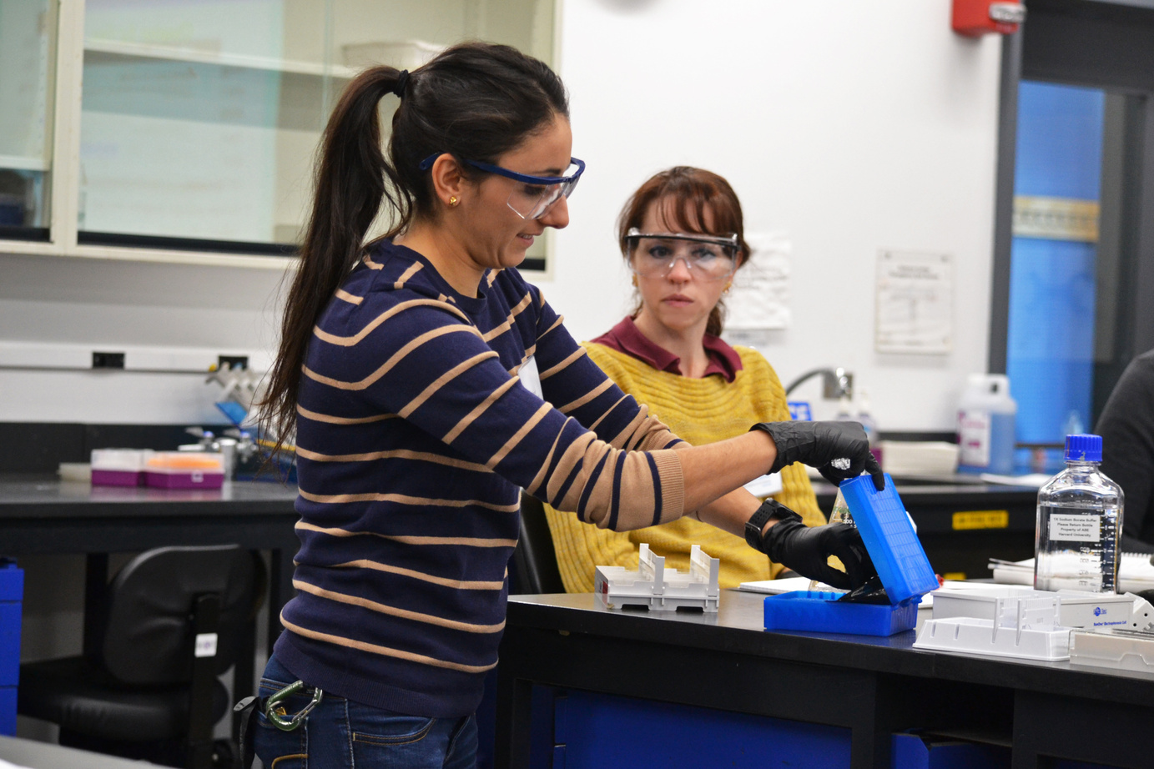
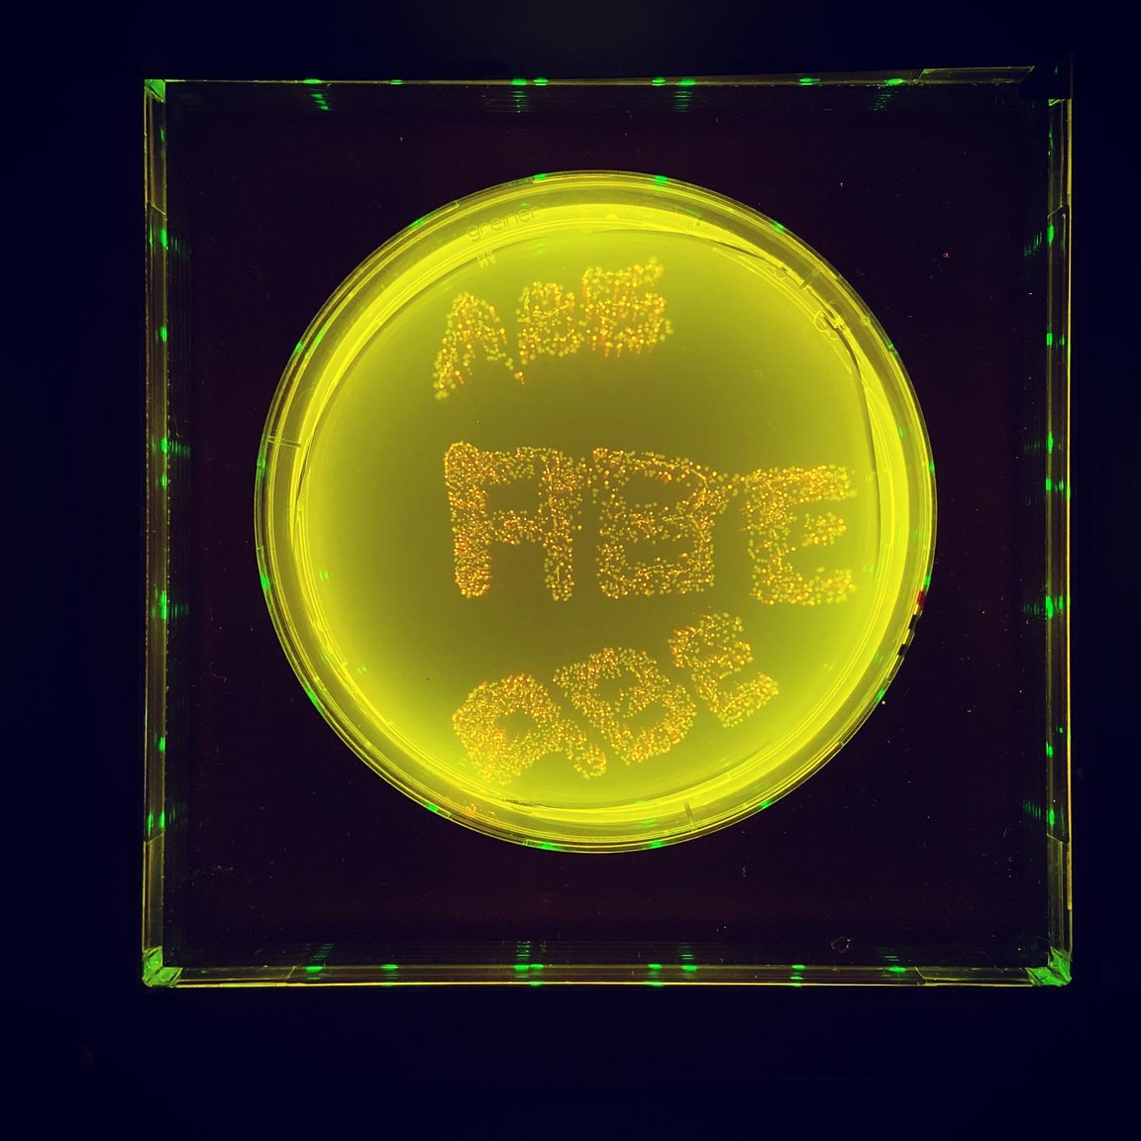
TEACHER BENEFITS
TRAINING
TECHNICAL SUPPORT
PROFESSIONAL COMMUNITY
ABE teachers are part of a global community with opportunities for high-quality professional learning and leadership, access to Amgen staff and industry partners, and connections to ABE teachers globally.

Slide 15
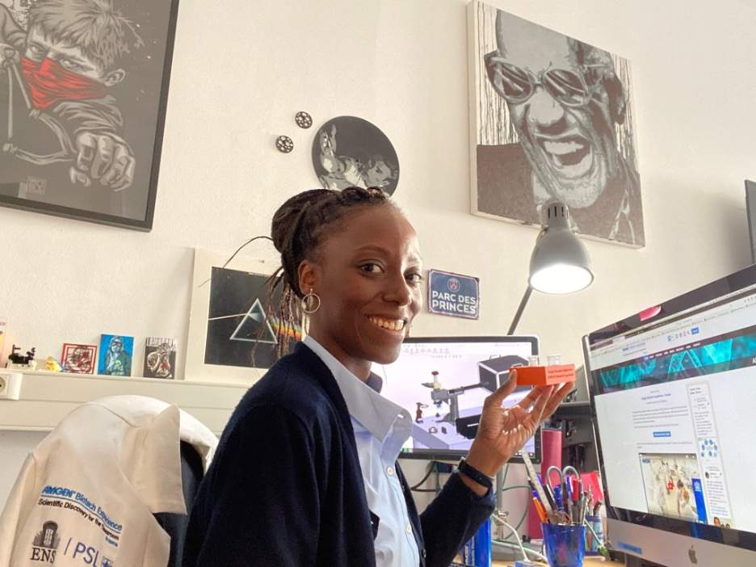
SITE STAFF
Program sites include staff with both the scientific and science education knowledge necessary for successful implementation of the ABE program.
Roles include:
  Site Director
  Site Liaison
  Site Coordinator
  Lab Technician
  Site Ambassador

Slide 16
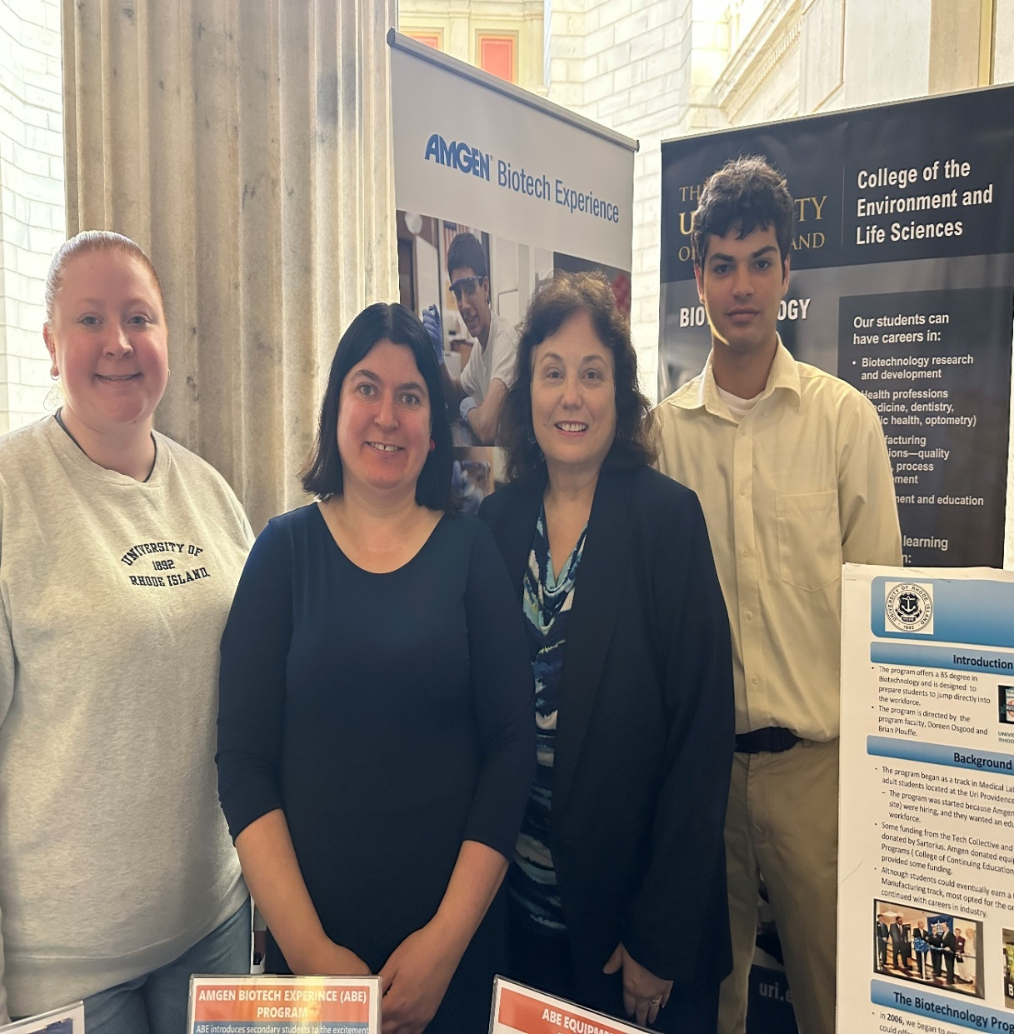
RI ABE SITE OFFICE
Doreen Osgood, PI, director, co-coordinator, liaison, and Diversity Ambassador
Arielle Chaves, co-coordinator and lead lab technician
Kim Basa: student lab assistant ( 2023-2024) recently graduated
Will Nebus: summer 2024 intern; student lab assistant 2024-2025
Haylie Burgess: student lab assistant 2024-2025
Alvan Van: New intern for Summer 2025
Visit our Instagram site: Abe.rhodeisland
RI site Website:https://amgenbiotechexperience.net/rhodeisland/

Slide 17
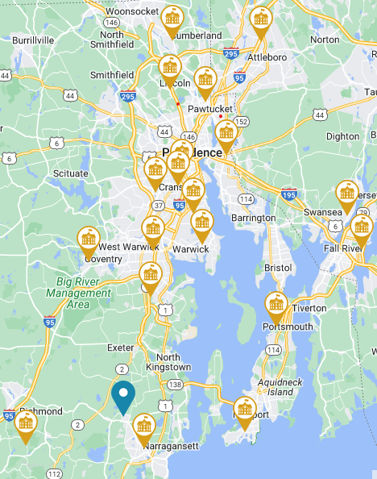
RI ABE: 2008 TO CURRENT
Schools involved
  RI
  CT
  MA
25 total schools: 20 participated 2023-2-25
  28 teachers participated in 2023-2024
  -33 teachers participated 2024-2025
79 total teachers (cumulative total since 2016)
~2000-2800 students/year

Slide 18
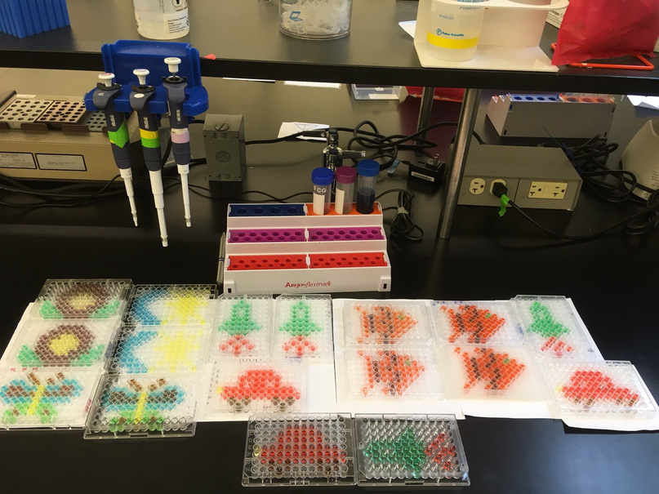
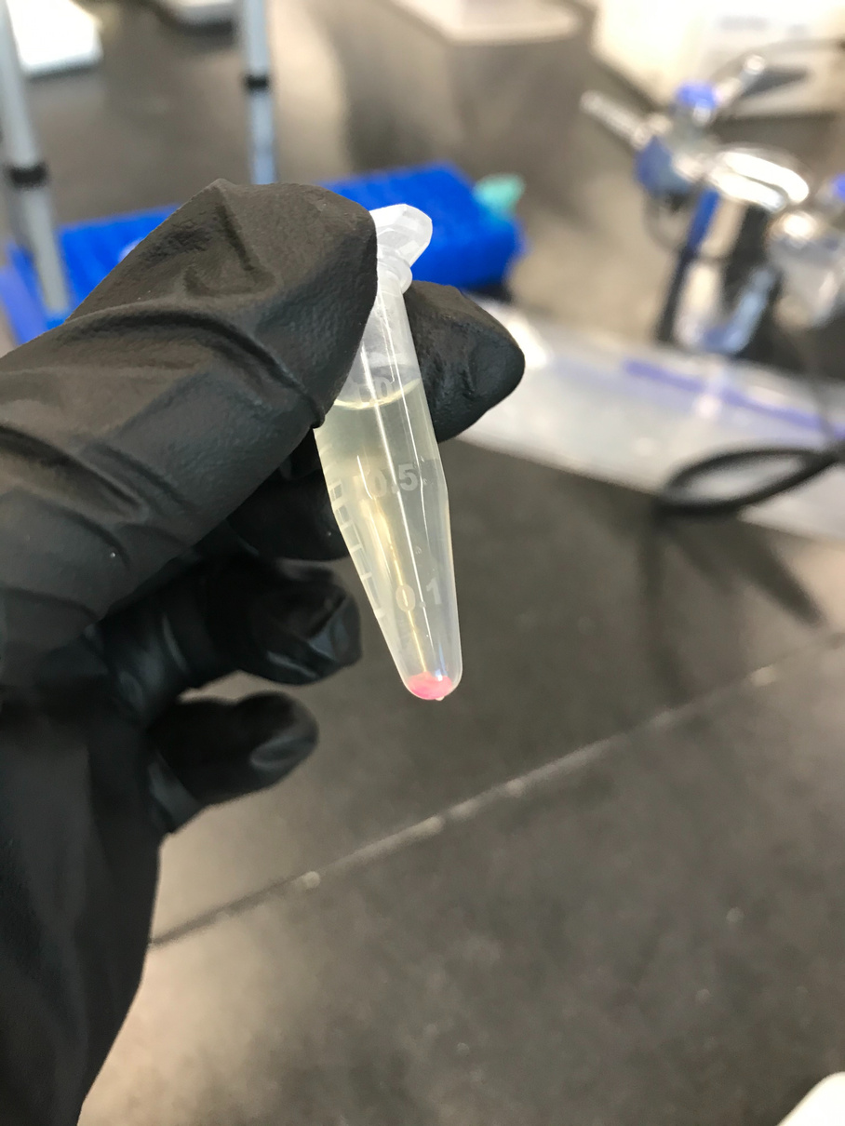
COMMUNITY OF PRACTICE
ABE program site staff engage in a global community of practice that helps them to:
Increase teacher capacity to implement ABE curriculum effectively
Develop lifelong engagement & interest in STEM for student participants
Develop site capacity to support effective ABE implementation within schools

Slide 19
SITE EVALUATION
ABE program sites evaluate their activities to support continuous improvement. This may include:
Evaluation of professional learning, curriculum implementation, & program support
Evaluation of progress toward meeting equity goals
Evaluation studies to learn about teacher & student outcomes

Slide 20

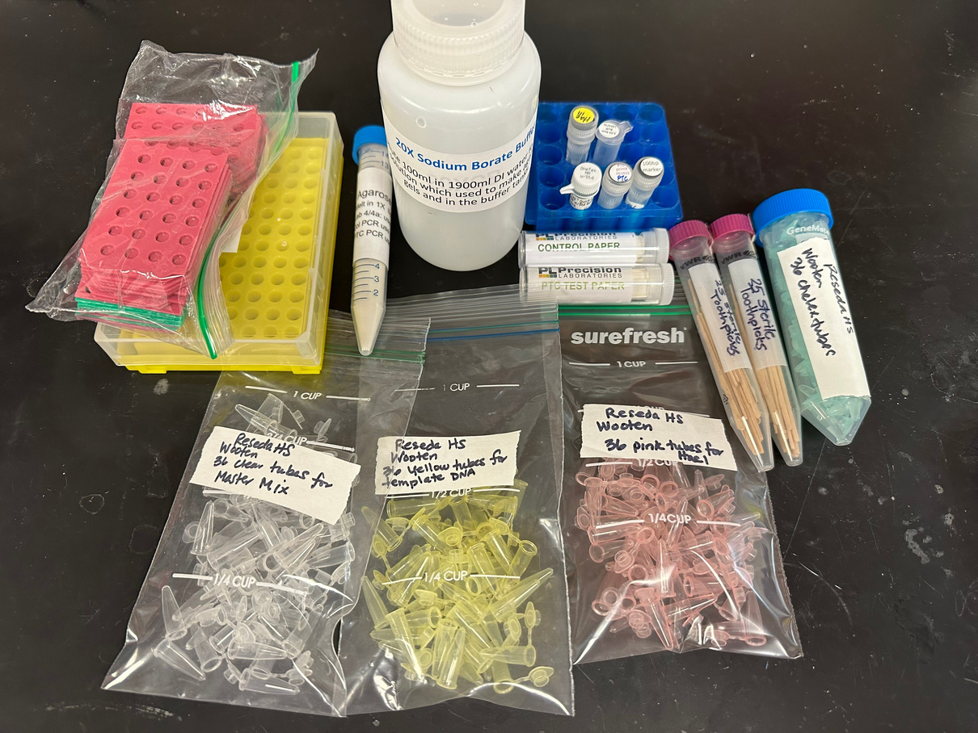



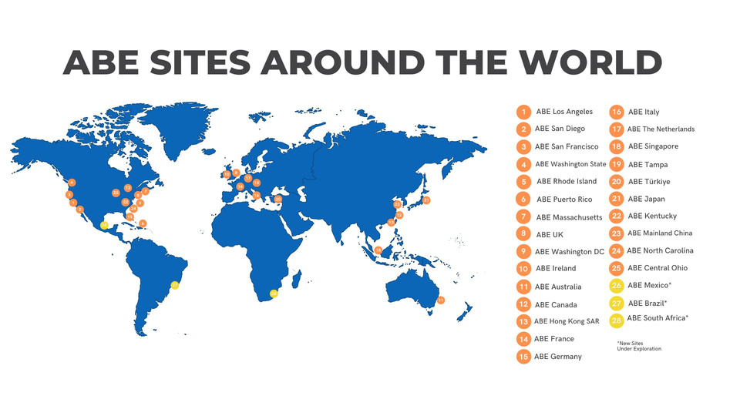
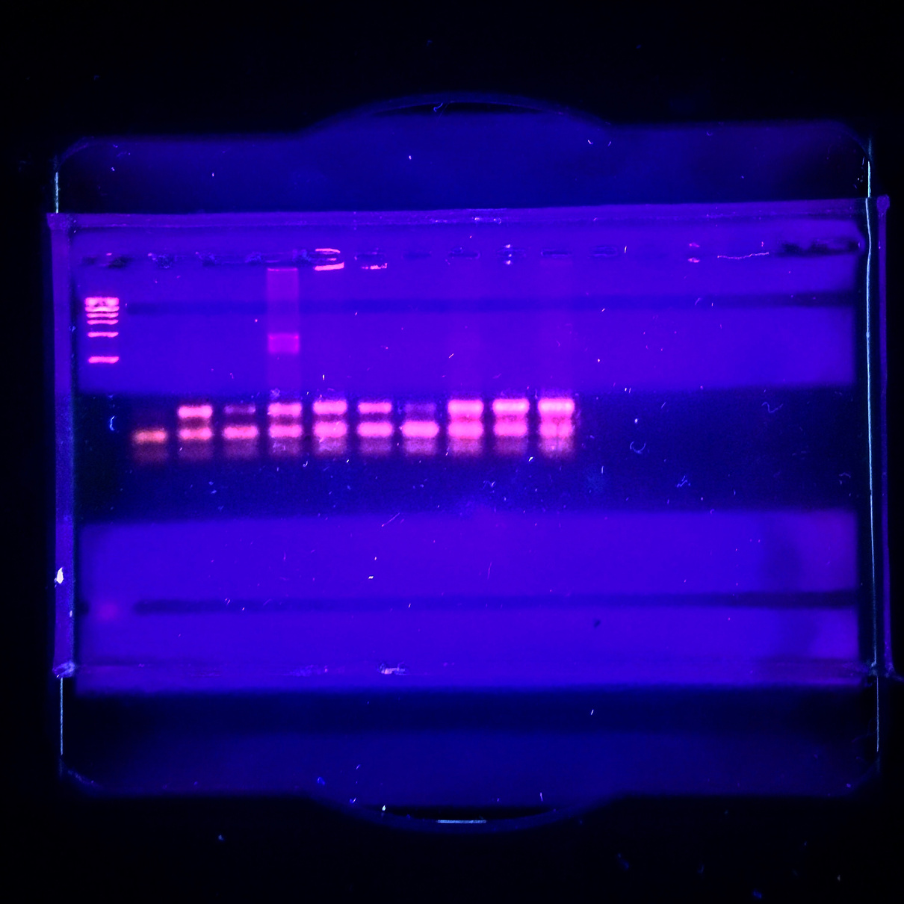
THE ABE PROGRAM OFFICE
CONTINUOUS
LEARNING & IMPROVEMENT
SITE SUPPORT
SUPPORTING
THE ABE
COMMUNITY
​
INNOVATION
SCALE
Notes:
Continuous Learning & Improvement: Uses data-informed approach to maintain current, timely, place-based understanding of program site health and efficacy
Site Support: Uses data-informed approach to maintain current, timely, place-based understanding of program site health and efficacy
Innovation: Creates conditions that invite, support, and disseminate creative and innovative ideas ​
Scale: Supports sites to set important and feasible goals for growth, and builds program site capacity to lead advancement toward strategic priorities

Slide 21


PROGRAM GROWTH SINCE
ESTABLISHMENT OF PROGRAM OFFICE
COUNTRIES
SITES
STUDENTS
1.3+ MILLION
~ 1 MILLION
16
28
13
25
300,000
2
9
2013
2023
2026 (PROJECTED)

Slide 22
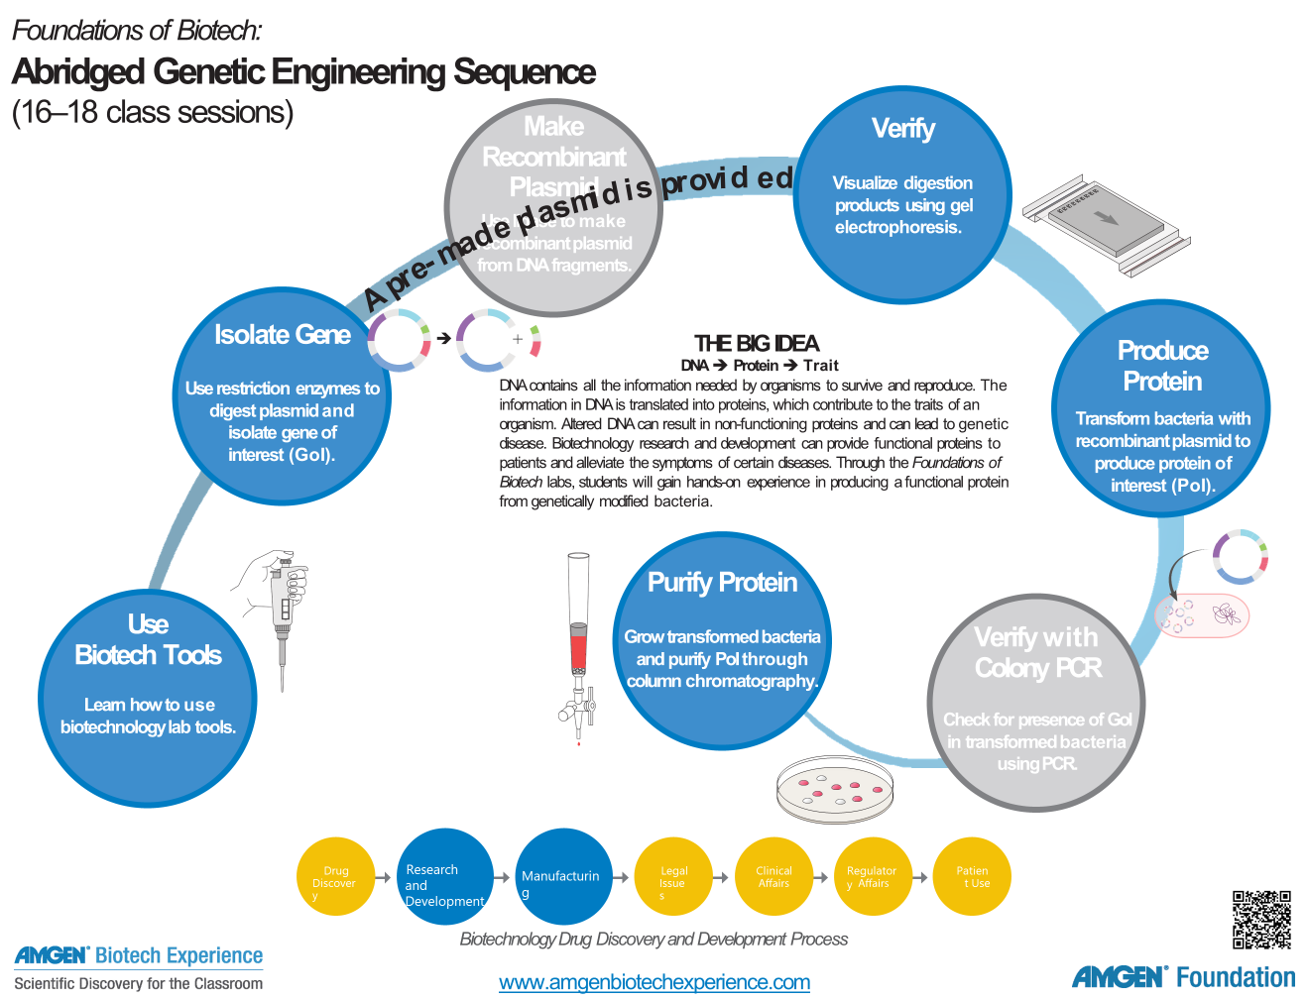
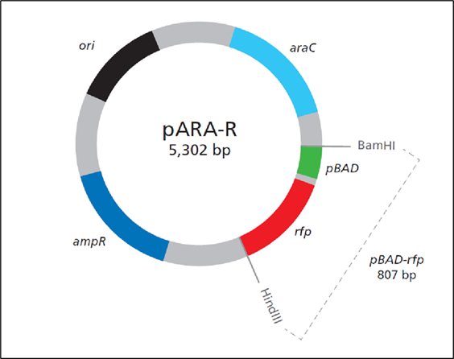

Slide 23
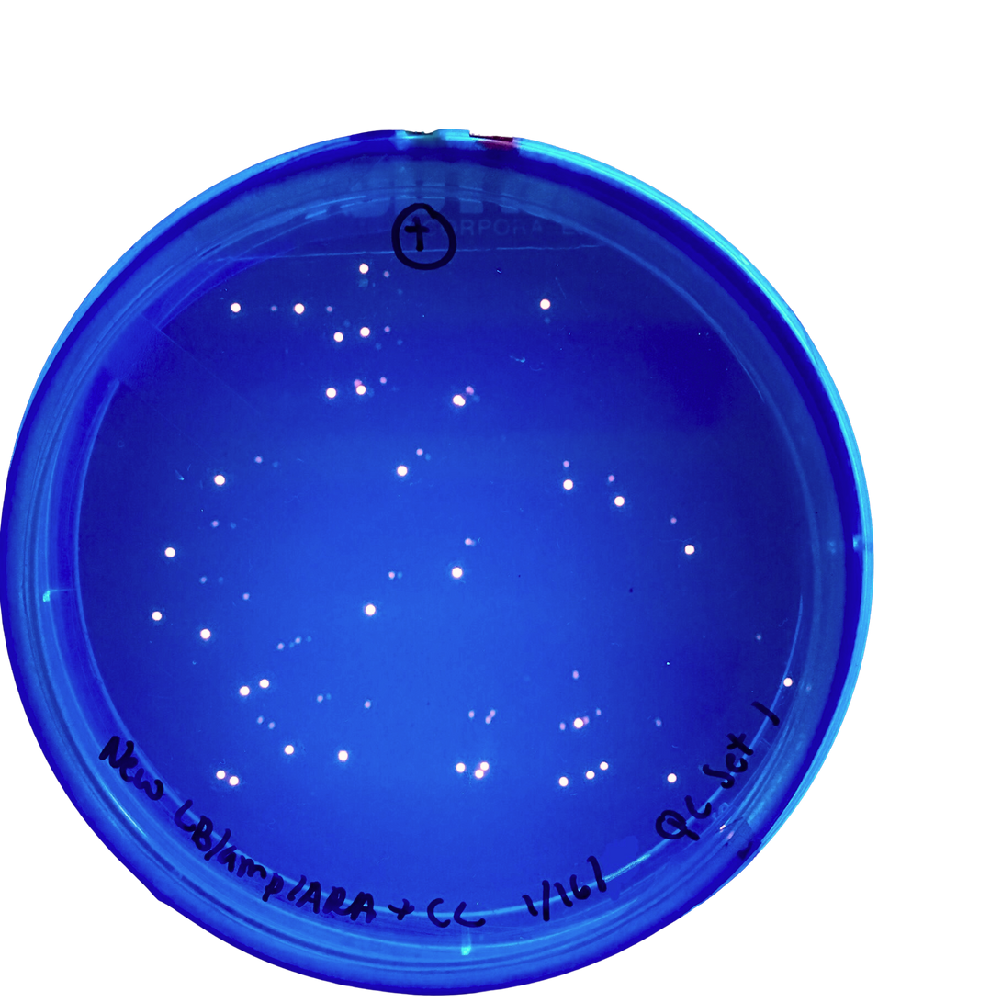




ABE CURRICULUM
LABORATORY-
BASED
CLASSROOM-
BASED
WEB-
BASED
Introduces biotechnology laboratory techniques and concepts
Hands-on activities to explore biotechnology in the classroom
Biotechnology investigations available in remote or hybrid learning environments

Slide 24
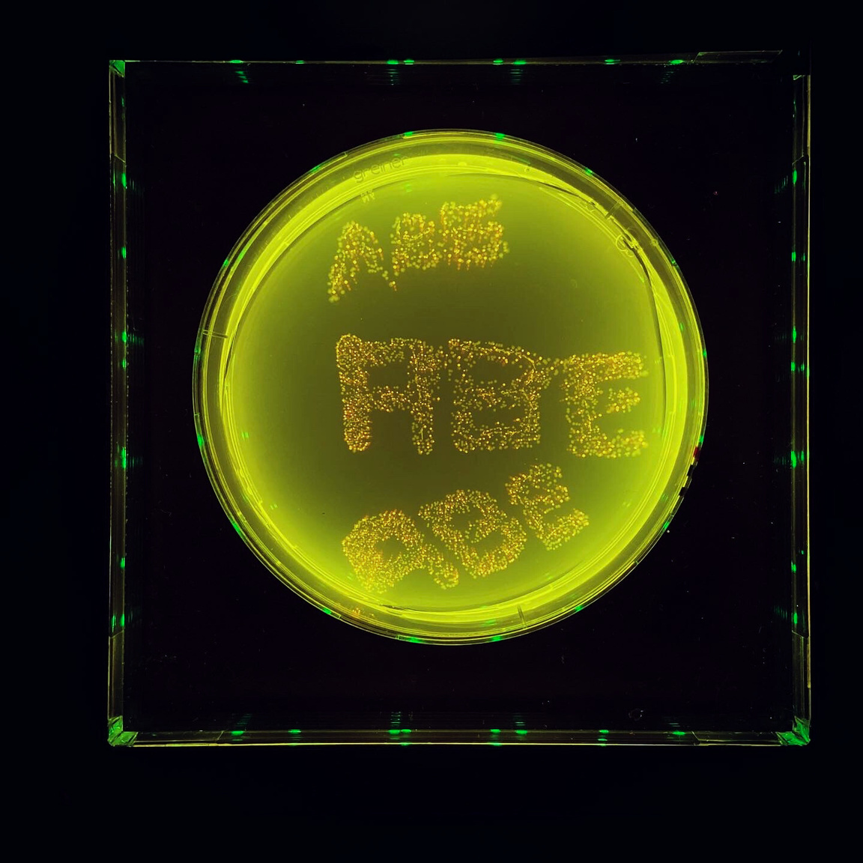
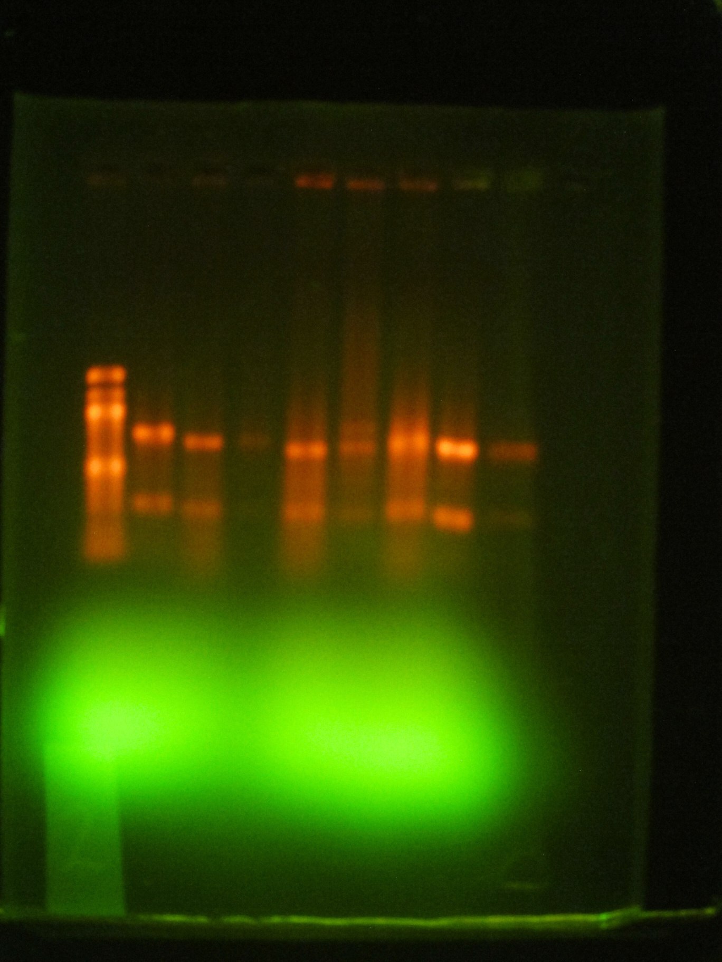
LABORATORY-BASED INVESTIGATIONS
FOUNDATIONS OF BIOTECH
EXPLORING PRECISION MEDICINE

Slide 25

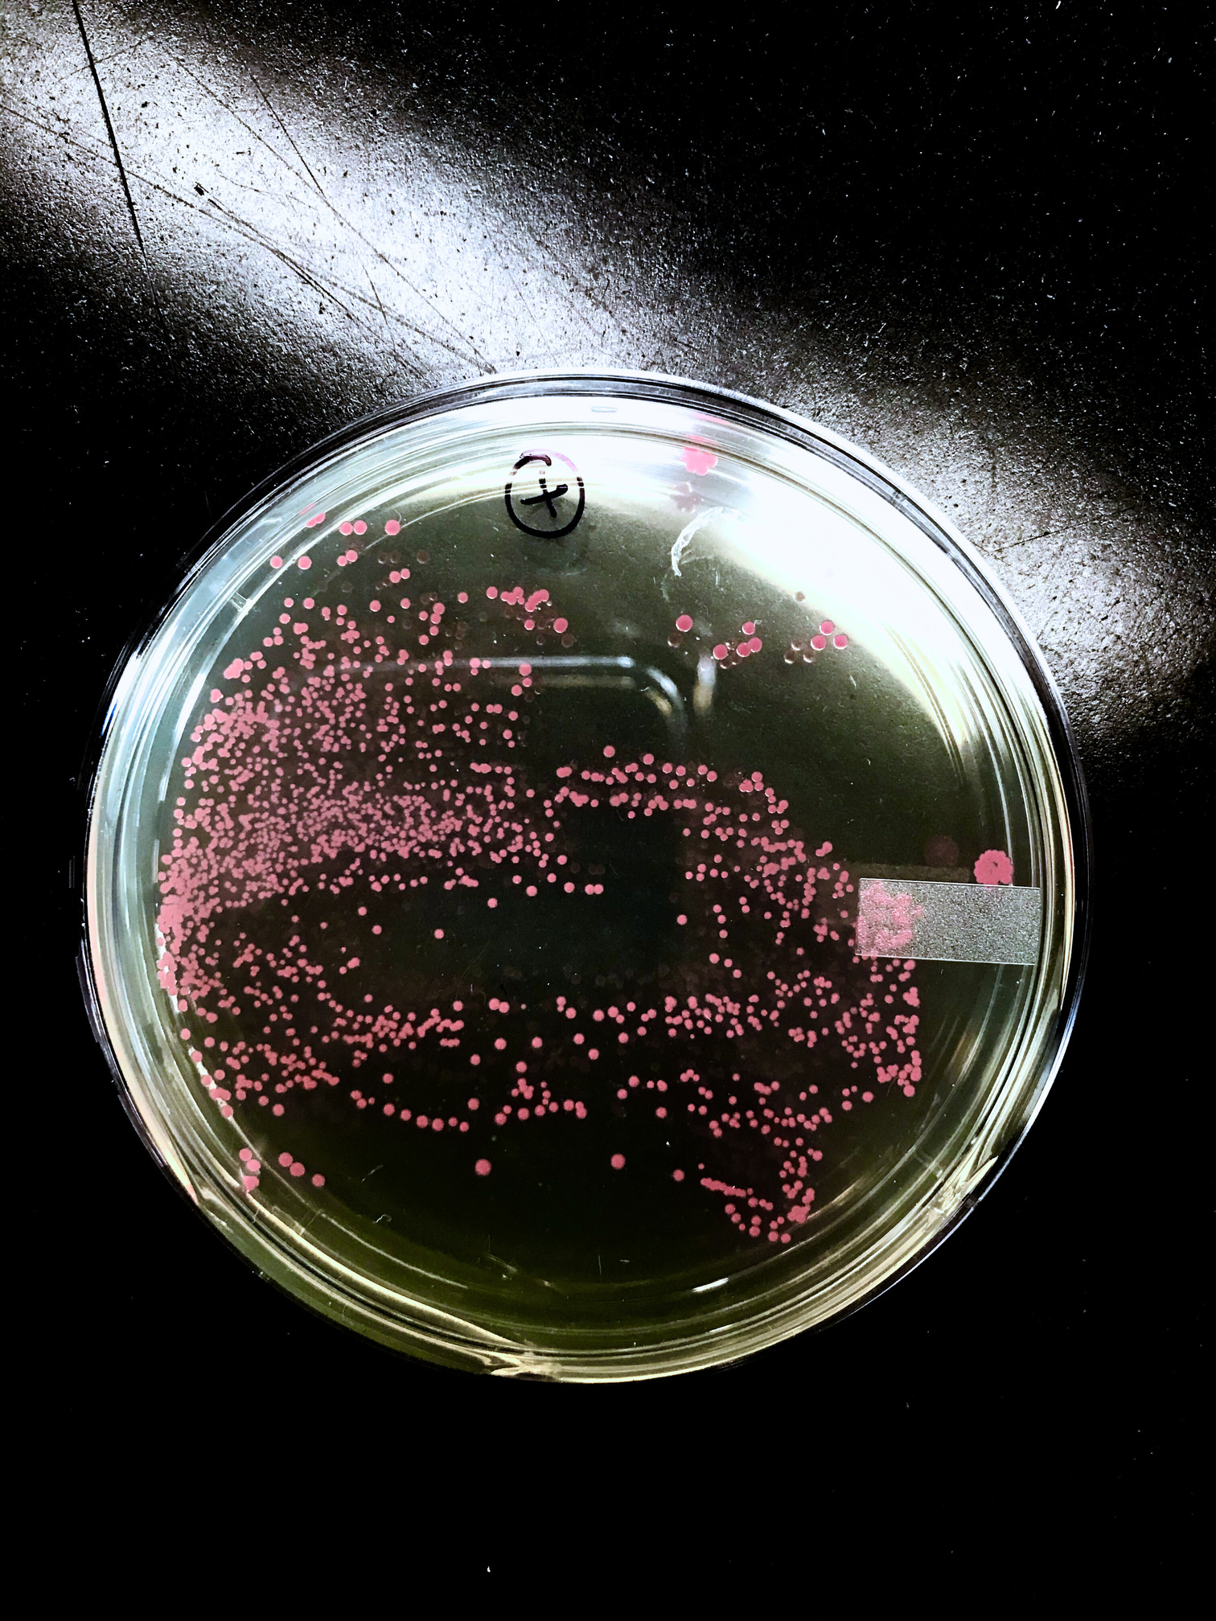

FOUNDATIONS OF BIOTECH HAS SEVERAL DIFFERENT LAB SEQUENCES AVAILABLE

Slide 26

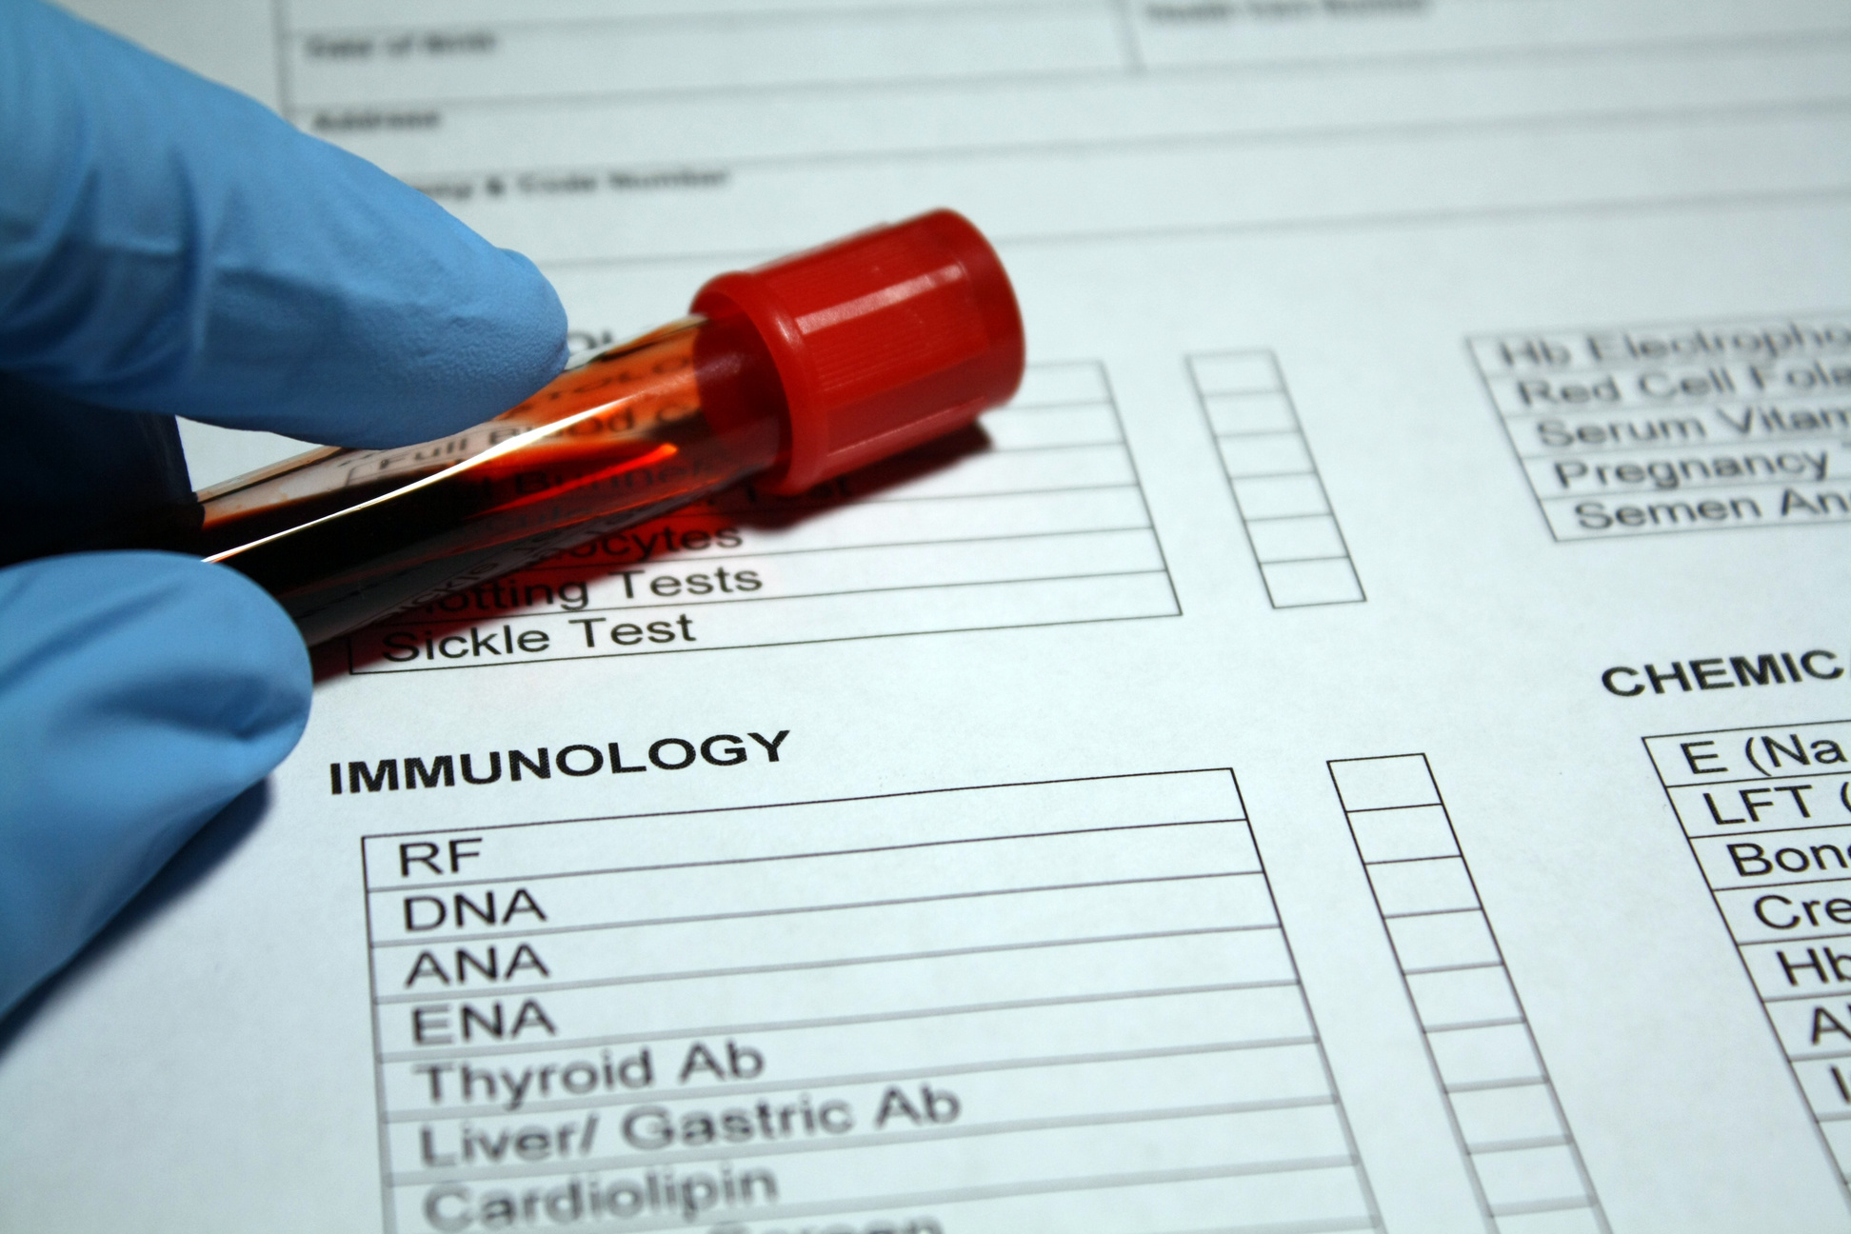


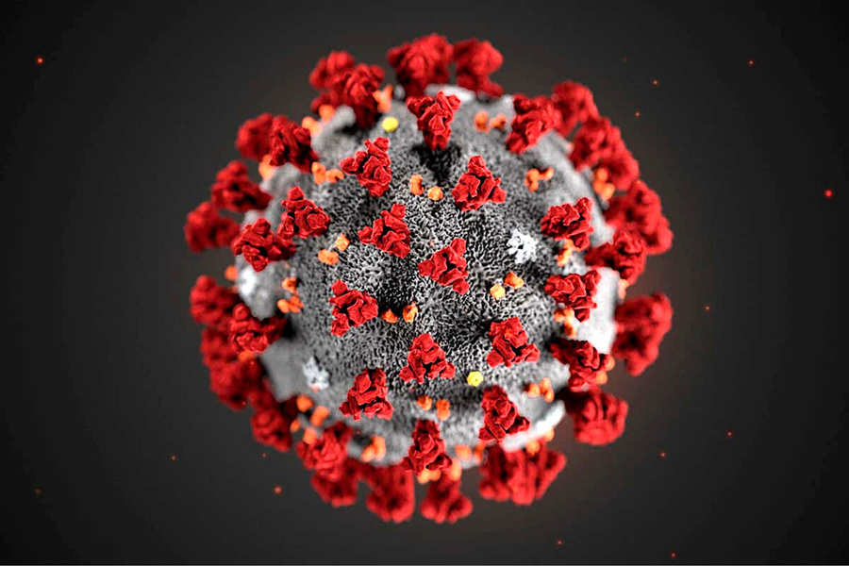
CLINICAL TRIALS
CRISPR
CLASSROOM-BASED INVESTIGATIONS
IMMUNOLOGY

Slide 27





RESPONDING TO A MYSTERY ILLNESS
BIOINFORMATICS
& DIABETES
BIOETHICS OF
GENE EDITING
SAVING
A LIFE
WEB-BASED INVESTIGATIONS

Slide 28
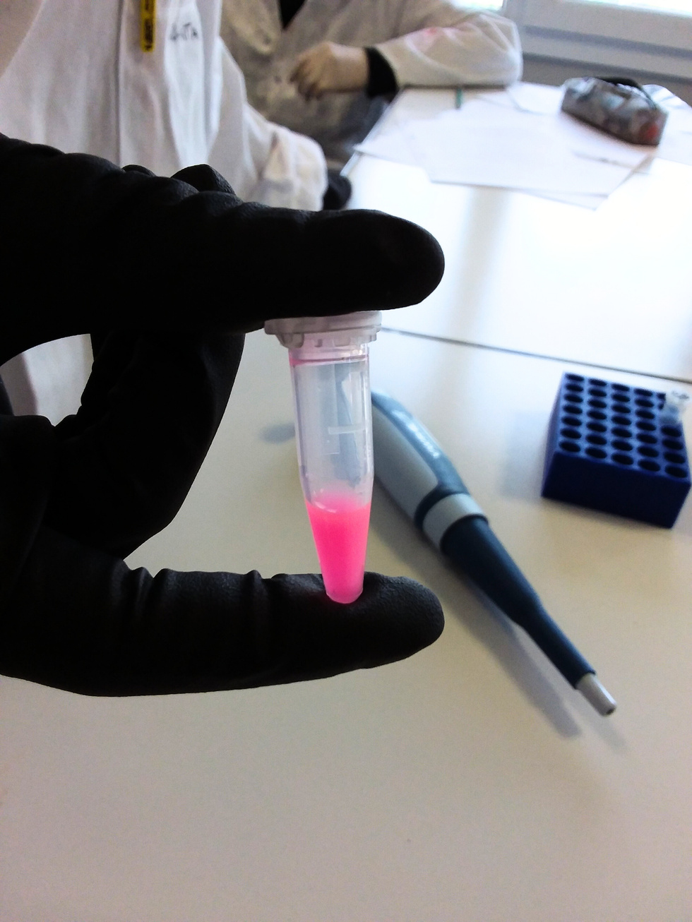





ABE EQUIPMENT & MATERIALS
PROGRAM SITES PROVIDE TEACHERS WITH RESEARCH-GRADE EQUIPMENT AND REAGENTS.
Notes:
The ABE program loans teachers a suite of equipment (and prepares and provides all necessary materials and reagents) needed to complete the ABE labs. Students have access to high quality laboratory equipment including:
Electrophoresis equipment
Pipettes and tips
Photo documentation system
Shaker (mini incubator shaker)
Microcentrifuge
Minifuge
Water Bath
Plastic microfuge tube racks
Incubator for Petri plates
Thermocycler

Slide 29
ABE PROFESSIONAL LEARNING
Resources support an international community of ABE teachers & program sites.
Resources reflect research-based culturally responsive strategies for adult learning.
Materials are practical, modular, & flexible, and are available in a variety of formats.

Slide 30
ABE PROFESSIONAL LEARNING
TEACHER CAPACITY
1
Increases teacher capacity to implement the ABE curriculum effectively
SITE CAPACITY
ABE supports sites and teachers through high-quality professional learning experiences, access to a global community of practice, and implementation resources.
2
Develops site capacity to support effective ABE implementation within schools
STUDENT ENGAGEMENT
3
Develops lifelong engagement and interest in STEM as students become members of the future workforce and active civic participants

Slide 31




RI SUMMER TEACHER WORKSHOP 2024 June 24-26, 2024

Slide 32



ABE PROFESSIONAL LEARNING & LABXCHANGE
The LabXchange platform can be a useful asset to educators who look to build, review, and expand their biotechnology skills.
ABE Foundations of Biotech and Exploring Precision Medicine are available on the LabXchange platform.

Slide 33

ABE MASTER TEACHER
FELLOWSHIP
RI site has had two Teacher fellows: David Upegui, Central Fall HS and Julie Panckowicz, Coventry High School
With support from the Program Office, ABE Master Teacher Fellows work independently and with other ABE teachers to explore a topic of personal interest in the biosciences, creating projects that push the boundaries of innovation within ABE.

Slide 34






ABE RI OUTREACH
ABE RI coordinator and lead lab technician, Arielle Chaves, demonstrating bacterial growth to Coventry HS students, March 2025.
South Kingstown High school NOCTI students( 2024) with teacher Mike Lobdell (right back) and URI biotech program undergraduate lab assistants Will Nebus (left back) and Kim Basa (left front).
Dr. Doreen Osgood (URI Biotech faculty and ABE RI director) showing proper use of ascetic technique to a Coventry HS student.
Arielle Chaves at Woonsocket Highschool talking about Biotechnology degree program and careers.
Automatic pipette
Skills with Dr. Osgood (Coventry HS, March 2025)
Aseptic transfer of cell culture reagents

Slide 35



ABE RI OUTREACH II
Left to Right: South Kingstown High school NOCTI students( 2024) and URI biotech program with Arielle Chaves ( ABE RI coordinator), undergraduate lab assistants Alvan Van and Will Nebus .
Coventry Career day April 23, 2025. Arielle Chaves and Will Nebus
Arielle Chaves at the South Kingstown High School Science Fair Jan 2025

